Slide 1
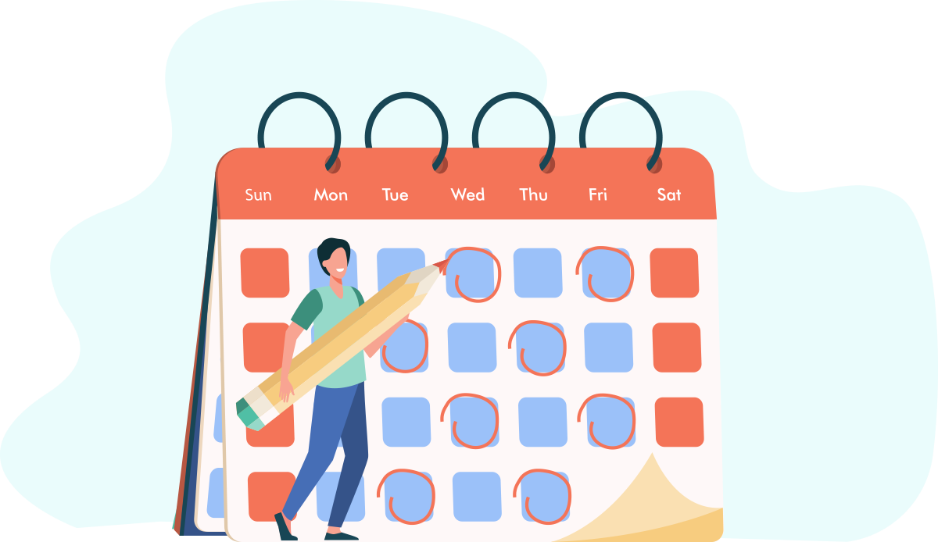
1. Post often
Notes:
I try to post every day. The rest of these tips won't work without consistency. ~1% of folks on LI post content. The minute you start you will be come a 1 percenter :-)

Slide 2

2. Be a social media concierge
Notes:
Your job is to help others and point them in the right direction.

Slide 3

3. Engage a lot
Notes:
I try to engage with multiple posts each day and leave at least 1 meaningful comment.

Slide 4
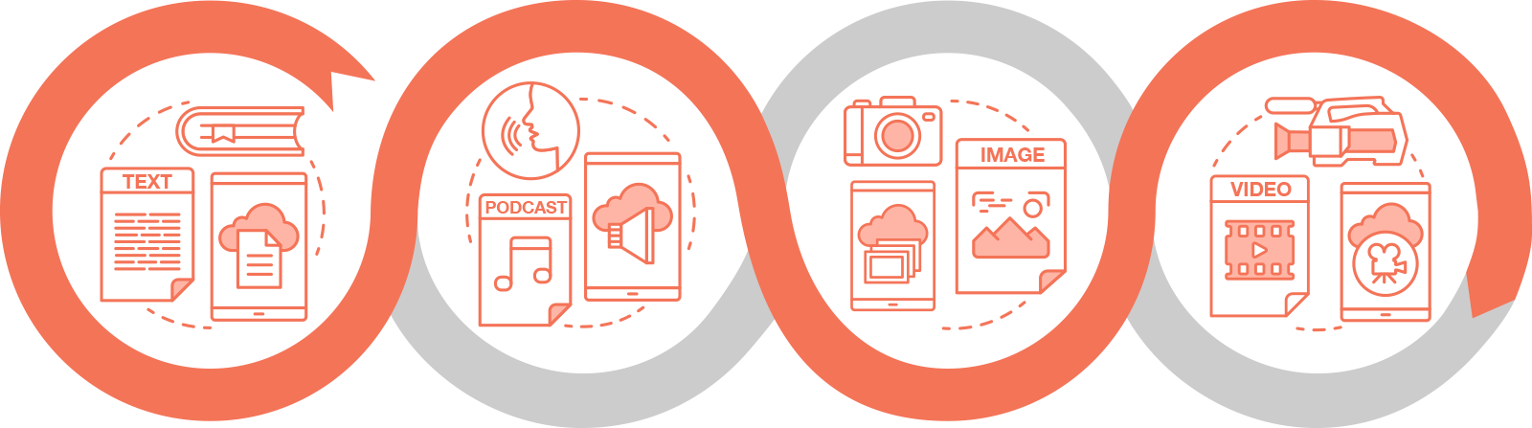
4. Mix it up
Notes:
Try text only, images, video, etc. to find what your audience likes.

Slide 5

5. Learn from others
Notes:
Find the influencers in your space and study what they do. Be sure to see what posts get the most engagement.

Slide 6

6. Interact with influencers
Notes:
Get to their posts early and a valuable comment.

Slide 7

7. Don't be afraid to give away your knowledge
Notes:
Teach your audience something new. Challenge their thinking.

Slide 8

8. Form engagement alliances
Notes:
Create groups of 5-10 people in your niche and support each other daily.

Slide 9
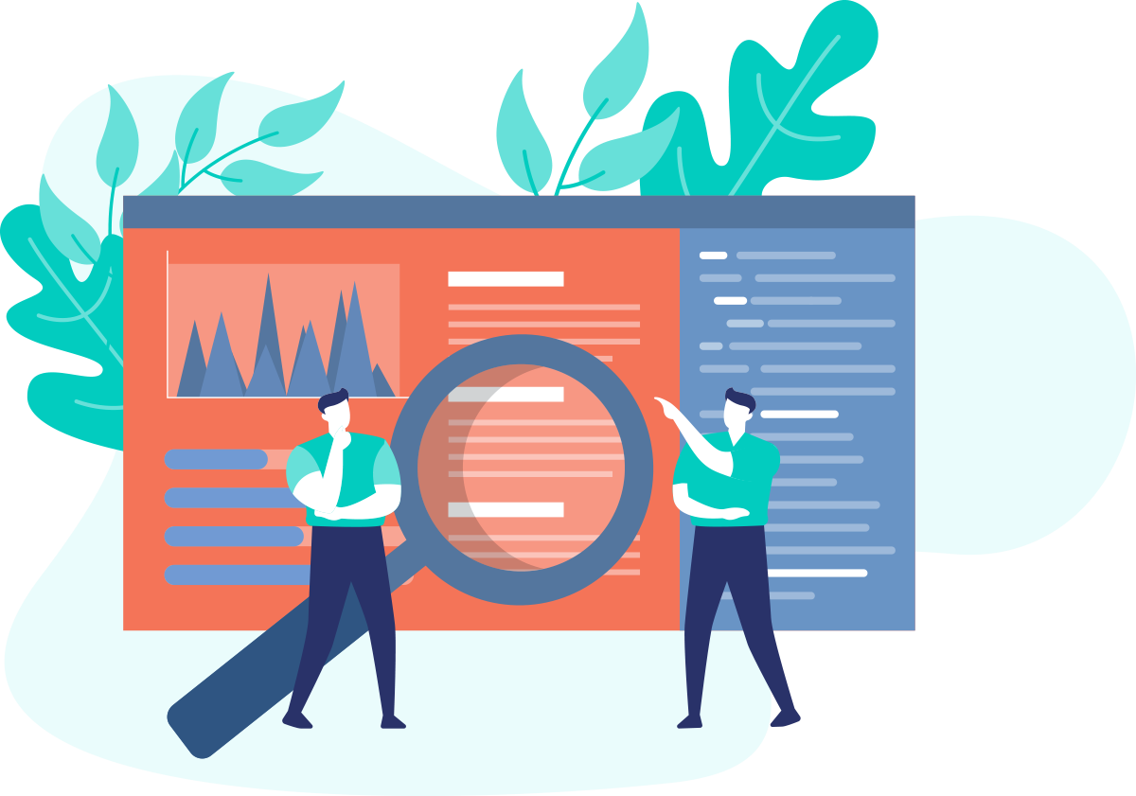
9. Be clear and concise
Notes:
If they can't figure out your post in 2 seconds they're out.

Slide 10
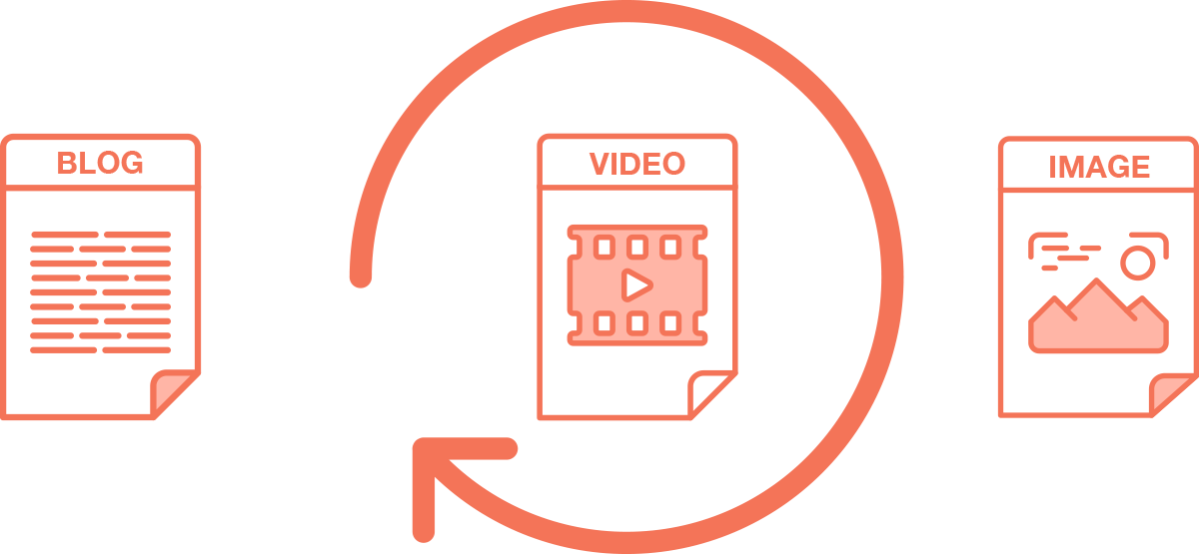
10. Repurpose your best stuff
Notes:
Look at the most popular content on your site and then repurpose into short easy to consume valuable content.

